Slide 1
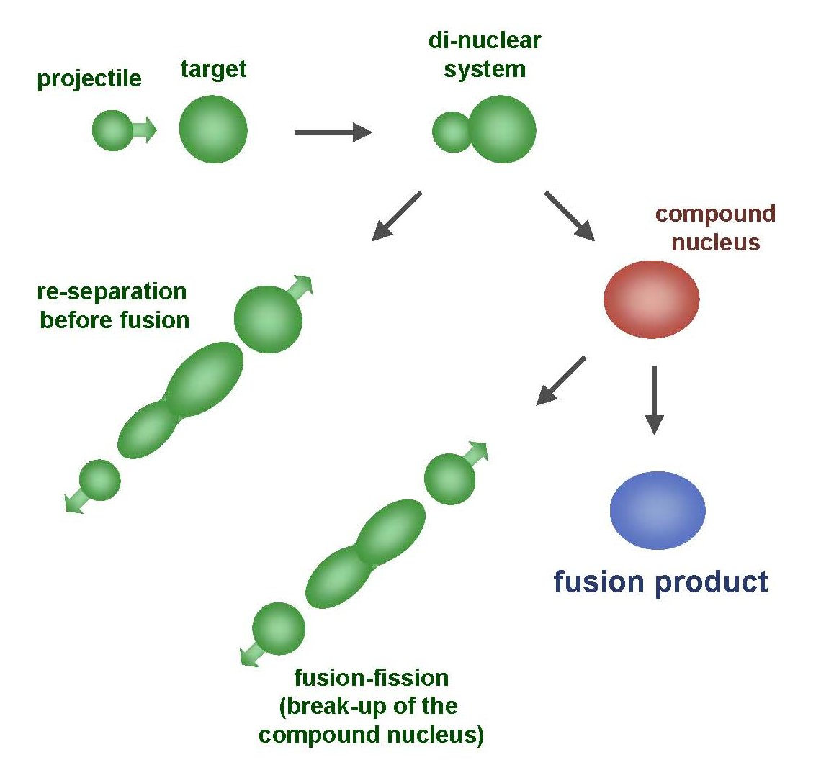
RDCH 702: Lecture 3, Nuclear Reactions
Readings: Modern Nuclear Chemistry, Chapter 10; Nuclear and Radiochemistry, Chapter 4
Notation
Energetics of Nuclear Reactions
Reaction Types and Mechanisms
  Barriers
  Scattering
Nuclear Reaction Cross Sections
Reaction Observables
Scattering
Direct Reactions
Compound Nuclear Reactions
Photonuclear Reactions
Nucleosynthesis

Slide 2
Nuclear Reactions
Nucleus reactions with a range of particles
  Nucleus, subatomic particle, or photon to produce other nuclei
  Short time frame (picosecond)
  Energetics involved in reaction
First nuclear reaction from Rutherford
  What reaction was this?
Number of terms conserved during nuclear reactions
  Basis for understanding and evaluating reactions
    Number of nucleons
      except in reactions involving creation or annihilation of antinucleons
    Charge
    Energy/Mass
    Momentum
    Angular momentum
    Parity
Q is the energy of the reaction
  positive Q corresponds to energy release
  negative Q to energy absorption
Q terms given per nucleus transformed
Shorthand:

Slide 3
Energetics
Energetically many orders of magnitude greater than chemical reactions
¹⁴N(α,p)¹⁷ O; Q=-1.193 MeV
  Convert energy to per molar basis
    1 eV = 1.60E-19 J
    =-7.18E23 MeV/mole= -7.18E29 eV/mole
    =-1.15E11 J/mole
Reactions so large that mass change is observable
Q value can be experimentally measured to provide a route to determine particle mass of reactants
  Mass and energy balance
    Know Q value, determine unknown mass

Slide 4
Energetics
Reaction Q values
  Not necessarily equal to kinetic energy of bombarding particles for the reaction to occur
    Need more energy than Q value for reaction to occur
      Reaction products will have kinetic energy that needs to come from reaction
Conservation of momentum
  Some particles’ kinetic energy must be retained by products as kinetic energy
Amount retained as kinetic energy of products
  Based on projectile mass
  Retained kinetic energy becomes smaller with increasing target mass
    Equation for kinetic energy (T):
What does this mean about reaction
  Heavier target or heavier projectile?
    ²⁴⁸Cm + ¹⁸O→²⁶⁶Rf
²⁴⁸Cm Projectile
¹⁸O Projectile

Slide 5
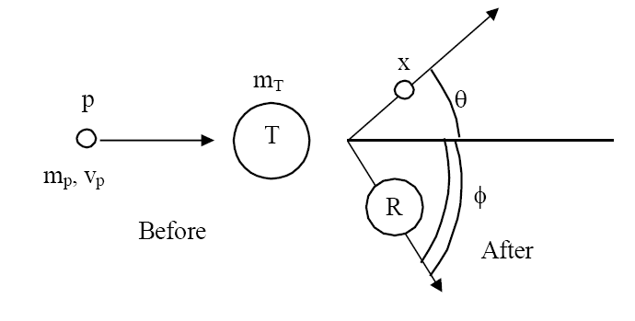
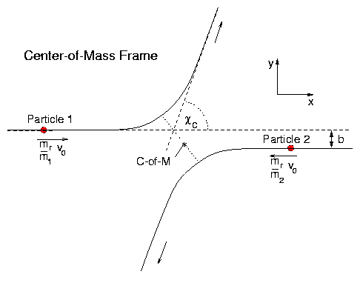
Energetics: Reaction Barrier
Need to consider laboratory and center of mass frame
Laboratory frame
  conservation of momentum considers angle of particles
Q value can be found if T_{x} and θ are measured and particles known
  T_{p} from experiment
Center of mass
  Total particle angular momentum is zero
Kinetic energy carried by projectile (T_{lab}) is not fully available for reaction
  T_{lab} - T_{cm} = T₀
  T₀ is energy to be dissipated in reaction
For reaction to occur Q + T₀ must be achieved
  Basis for threshold reaction
  Q + T₀ > 0

Slide 6
Reaction Barrier
Threshold energy (minimum energy for reaction)
Fraction of bombarding particle’s kinetic energy retained as kinetic energy of products becomes smaller with increasing mass of target
  Heavier target or heavier projectile?
  ²⁴⁸Cm + ¹⁸O→²⁶⁶Rf
Solve of laboratory T
A for mass

Slide 7
Reaction Barrier: Threshold Energy
Consider the ¹⁴N(α,p)¹⁷O reaction
  Find threshold energy
    Q from mass excess
      Q=2.425 + 2.863 – 7.289 – (-0.809) = -1.19 MeV
Reaction barrier also induced by Coulomb interaction
  Need to have enough energy to react and overcome Coulomb barrier
    From charge repulse as particle approach each other
      R is radius
      r_{o} =1.1 to 1.6 fm
Equation can vary due to r_{o}
V_{c} can be above threshold energy
Center of mass, need to bring to laboratory frame
  Consider kinetic energy carried by projectile
  3.36x ((14+4)/14) = 4.32 MeV alpha needed for reaction

Slide 8
Equations for production reactions: Cross Sections
Probability of a nuclear process is generally expressed in terms of a cross section σ
  dimensions of an area
Originates from probability for reaction between nucleus and impinging particle is proportional to the cross-sectional target area presented by the nucleus
  Doesn’t hold for charged particles that have to overcome Coulomb barriers or for slow neutrons
Total cross section for collision with fast particle is never greater than twice the geometrical cross-sectional area of the nucleus
  cross section σ is close to 1 barn for this case
10⁻²⁴ cm²=1 barn

Slide 9
Cross sections
Accelerator: beam of particles striking a thin target with minimum beam attenuation
When a sample is embedded in a uniform flux of particles incident on it from all direction, such as in a nuclear reactor, the cross section is defined:
  R_{i}= # of processes of type under consideration occurring in the target per unit time
  I= # of incident particles per unit time
  n= # of nuclei/cm³
  x=target thickness (cm)
  φ=flux of particles/cm²/sec
  N=number of nuclei contained in sample

Slide 10
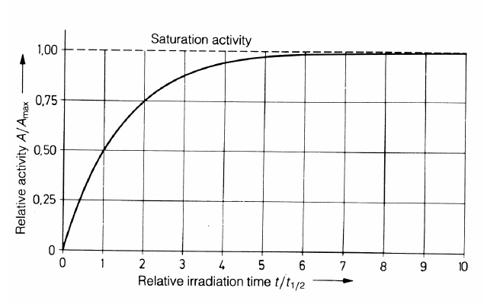
Production of radionuclides
  σ=cross section
  φ=neutron flux
  t=time of irradiation
    (1-e^{-(λt)})
      maximum level (saturation factor)
Activity of radioactive product at end bombardment is divided by saturation factor, formation rate is obtained
  R=A/(1-e^{-(λt)})
half life | %
1 | 50
2 | 75
3 | 87.5
4 | 93.75
5 | 96.875

Slide 11
Nuclei production: Short irradiation compared to half-life
Find amount of ⁵⁹Fe (t_{1/2}=44.5 d, λ = 1.803E-7 s⁻¹) from irradiation of 1 g of Fe in a neutron flux of 1E13 n/cm²/s for 1 hour
  ⁵⁸Fe(n,γ)⁵⁹Fe: ⁵⁸Fe+ n →γ + ⁵⁹Fe σ=1.3E-24 cm²
  N_{o}= 1g/55.845 g/mol *6.02E23 atom/mol*0.00282
  N_{o}=3.04E19 atom
R= 1E13 n/cm²/s *1.3E-24 cm² * 3.04E21 atom
R=3.952E8 atoms/sec
1.423E12 atoms ⁵⁹Fe in 1 hour

Slide 12
Nuclei production: Long irradiation compared to half-life
Find amount of ⁵⁶Mn (t_{1/2}=2.578 hr, λ = 7.469E-5 s⁻¹) from irradiation of 1 g of Mn in a neutron flux of 1E13 n/cm²/s for 1 hour
  ⁵⁵Mn(n,γ)⁵⁶Mn: ⁵⁵Mn+ n →γ + ⁵⁶Mn σ=13.3E-24 cm²
  N_{o}= 1g/54.93804 g/mol *6.02E23 atom/mol
  N_{o}=1.096E22 atom
R= 1E13 n/cm²/s *13.3E-24 cm² * 1.096E22 atom
R=1.457E12 atoms/sec
5.247E15 atoms ⁵⁶Mn in 1 hour (does not account for decay)

Slide 13
Formation rate from activity
R=A/(1-e^{-(λt)})
4.603E15 atoms ⁵⁶Mn (t_{1/2}=2.578 hr, λ = 7.469E-5 s⁻¹) from 1 hour irradiation
A=λN= 4.603E15* 7.469E-5 =3.436E11 Bq
R=A/(1-e^{-(λt)})
R= 3.436E11/(1-exp(- 7.469E-5 *3600))
R=1.457E12 atom/sec

Slide 14
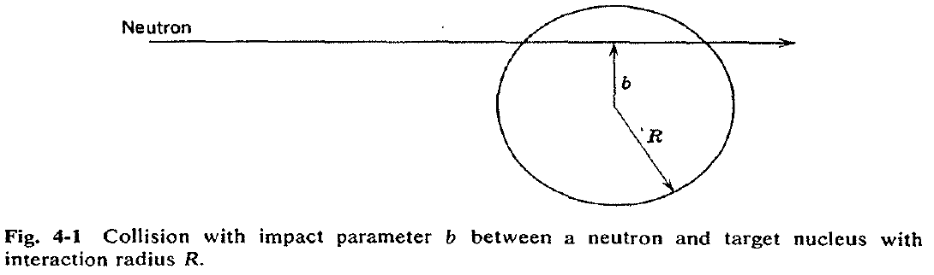
Cross Section Values and Limits
Reaction cross section of πR² is approximated at high energies
  Wave nature of incident particle causes upper limit of reaction cross section to include de Broglie wavelength
    So cross section can be larger than area due to incoming particle wavelength
    Expressed as an increase in R, quantum in nature
Collision between neutron and target nucleus characterized by distance of closest approach
  B is impact parameter

Slide 15
Cross sections
Angular momentum of system is normal to the relative momentum p
b any value between 0 and R
l =0,1,2,…b angular momentum
  lħ
Sum all l from 0 to l_{max}
Cross section based on summation of l cross sections
For this reason nuclear reaction cross sections can be several orders of magnitude larger than the nuclear geometrical cross section
  Manifest by slow-neutron reactions

Slide 16
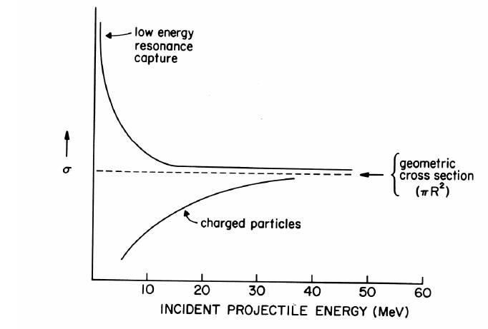
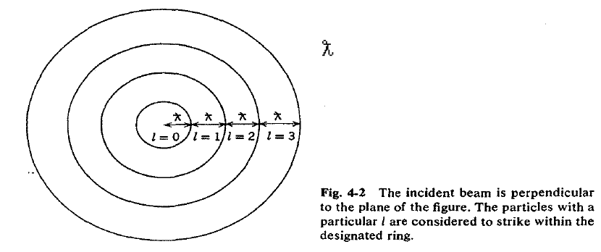
Cross section
σ_{l} is partial cross section of given angular momentum l
Quantum-mechanical treatment T_{l} is the transmission coefficient for reaction of a neutron with angular momentum l
  Represents fraction of incident particles with angular momentum l that penetrate within range of nuclear forces
    Provides summing term to increase cross section
    Reason why cross section can be larger than physical size of nucleus
General trends for neutron and charged particles
  Charged particle cross section minimal at low energy
  Neutron capture cross section maximum at low energy

Slide 17
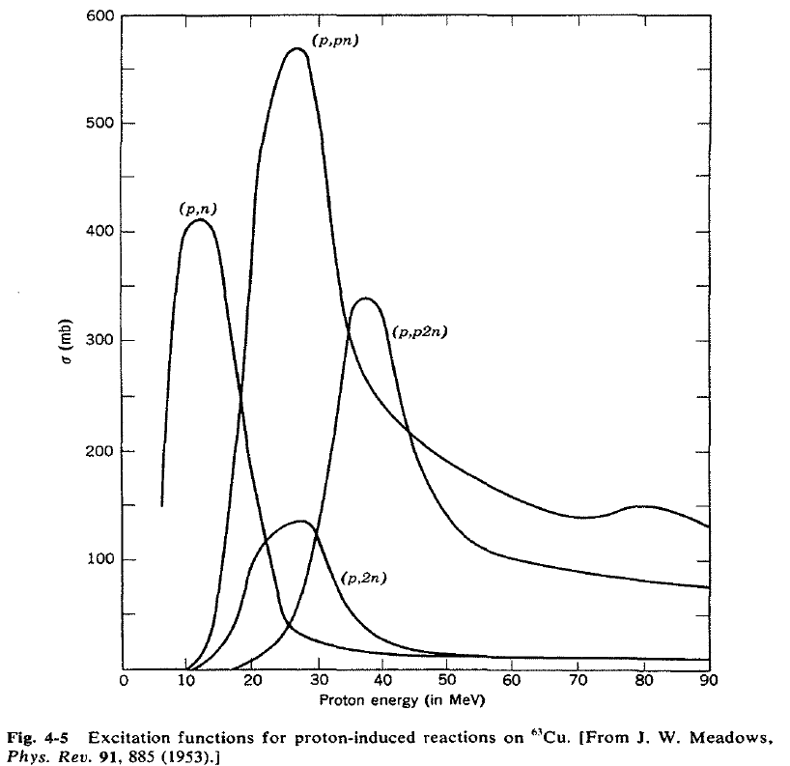
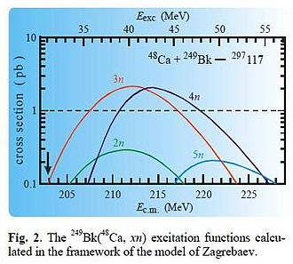
Measuring Cross Section: Excitation Functions
Variation of reaction cross section with incident energy
Shape can be determined by exposing several target foils in same beam with energy-degrading
  Simultaneous measurement of multiple particle energies
Provide information about probabilities for emission of various kinds and combination of particles in nuclear reactions
  formation of given product implies what particles were ejected from target nuclide
Range of cross sections can be evaluated
  Detection limit of product can influence cross section limit measurement

Slide 18
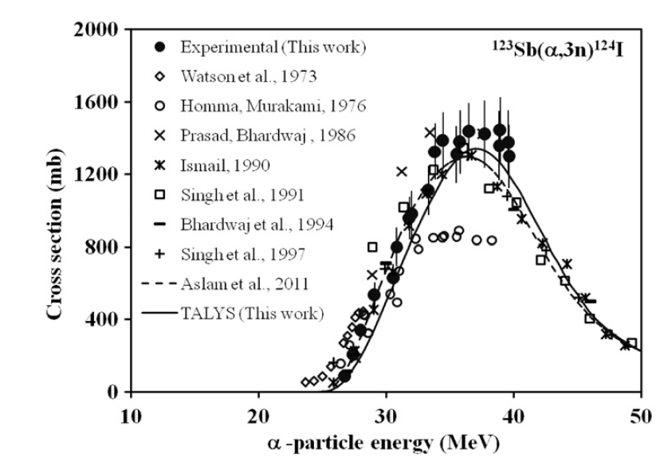
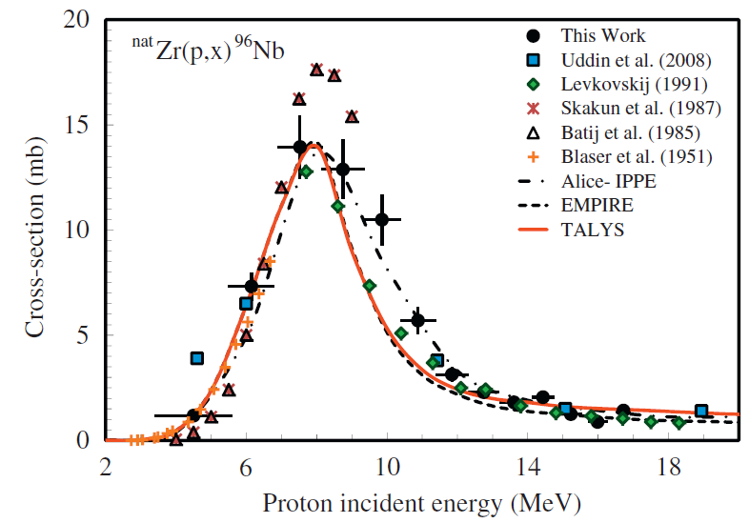
Barriers for Charged Particles
Coulomb repulsion between charged bombarding particles and nucleus
  Repulsion increases with decreasing distance of separation until charged particle comes within range of nuclear forces
  Probability of tunneling through barrier drops rapidly as energy of particle decreases
  Coulomb barriers affect charged particles both entering and leaving the nucleus
    Charged particles emitted from nuclei experience Coulomb repulsion during emission
    greater than 1 MeV
    seen with position emission
Related to change in cross section with energy for charged particle reactions
  Maximum cross section dependent upon energy

Slide 19
RDCH 702: Lecture 3, Nuclear Reactions
Readings: Modern Nuclear Chemistry, Chapter 10; Nuclear and Radiochemistry, Chapter 4
Notation
Energetics of Nuclear Reactions
Reaction Types and Mechanisms
  Barriers
  Scattering
Nuclear Reaction Cross Sections
Reaction Observables
Scattering
Direct Reactions
Compound Nuclear Reactions
Photonuclear Reactions
Nucleosynthesis

Slide 20
Reactions: Elastic Scattering
Elastic scattering
  kinetic energy conserved
  Particles do not change
Simplest consequence of a nuclear collision
  Not a “reaction”
    no exchange of nucleons or creation of particles
Particles do not change their identity during the process and the sum of their kinetic energies remains constant
Elastic scattering will also have a contribution from nuclear forces

Slide 21
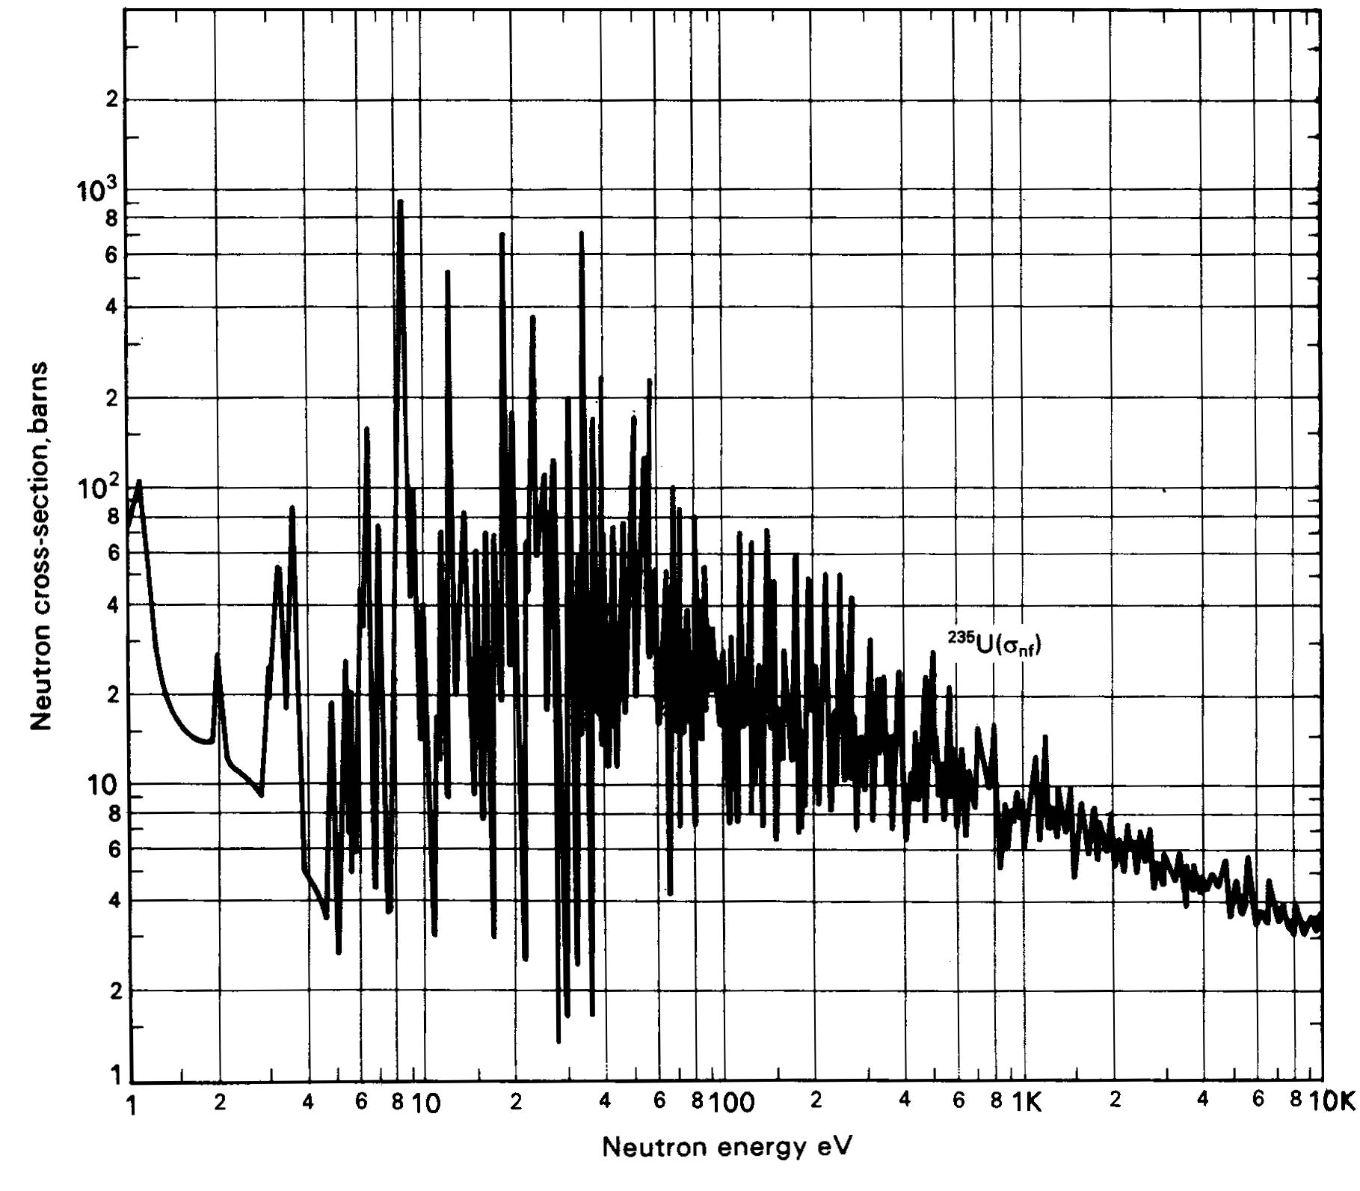
Low-Energy Reactions with Light Projectiles
Slow-Neutron Reactions
  Purest example of compound-nucleus behavior
    1/v law governs most neutron cross sections in region of thermal energies
  neutrons available only from nuclear reactions
    Range of energies can be obtained
Reaction Cross Sections
  Coulomb barrier prevents study of nuclear reactions with charged particles below 1 MeV
    resonances no longer observable
    with increasing energy, increasing variety of reactions possible

Slide 22
Low-Energy Reactions
Deuteron Reactions
  Prevalence of one nucleon stripping
    large size and loose binding of deuteron
    Only proton and neutron in deuteron nucleus
      Proton charge carries both nucleons
  Neutron comes within range of nuclear forces while proton is still outside most of Coulomb barrier
    Inherent in large neutron-proton distance in deuteron
    weakly bound deuteron can be broken up
      proton outside barrier
Competition among Reactions
  depends on relative probabilities for emission of various particles from compound nucleus
    determined by number of factors
      energy available
      Coulomb barrier
      density of final states in product nucleus

Slide 23
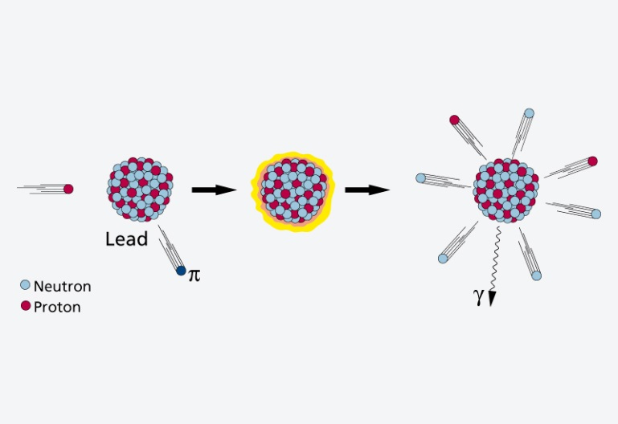
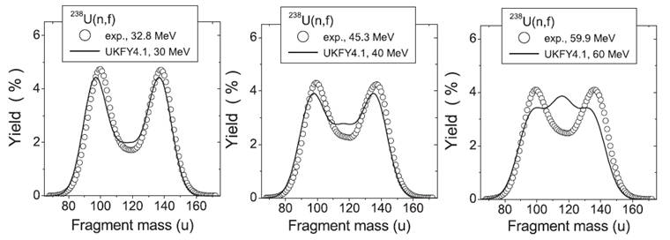
High Energy Reactions
Spallation Products
  products in immediate neighborhood of target element found in highest yields
    within 10 to 20 mass numbers
  yields tend to form in two regions
  β stability for medium-weight products
  neutron-deficient side of stability with increasing Z of products
  Used to produce beam of neutrons at spallation neutron source
    Heavy Z will produce 20-30 neutrons
    Basis of Spallation neutron source (http://neutrons.ornl.gov/facilities/SNS/)
High-Energy Fission
  single broad peak in mass-yield curve instead of double hump seen in thermal-neutron fission
  many neutron-deficient nuclides
    especially among heavy products
    originate from processes involving higher deposition energies
    lower kinetic energies
    do not appear to have partners of comparable mass
    arise from spallation-like or fragmentation reactions

Slide 24
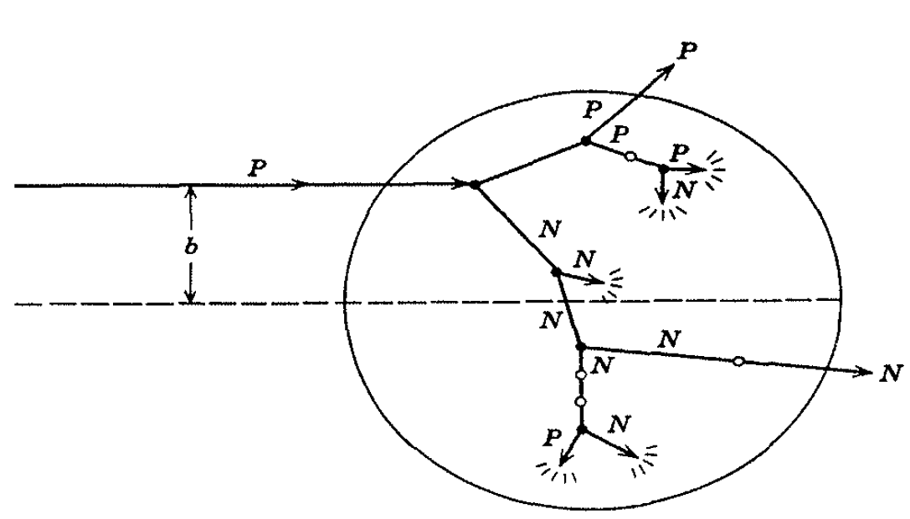
High-Energy Reactions
Mass-Yield Curves
  at low energies, compound-nucleus picture dominates
    as energy increases importance of direct reactions and preequilibrium (pre-compound nucleus) emission increase
    above 100 MeV, nuclear reactions proceed nearly completely by direct interactions
  products down to mass number 150 are spallation products
  those between mass numbers 60 and 140 are fission products
Cascade-Evaporation Model
  Above 100 MeV reactions
  energy of the incident proton larger than interaction energy between the nucleons in the nucleus
  Wavelength less than average distance between nucleons
    proton will collide with one nucleon at a time within the nucleus
      high-energy proton makes only a few collisions in nucleus
      Produces nucleons with high energy

Slide 25
Heavy-Ion Reactions
Range of heavy ion reactions
  elastic and inelastic scattering
  compound-nucleus formation,
  direct interactions
  deeply inelastic reaction
Reactions influence by parameter
  impact parameter of collision
  kinetic energy of projectile
  masses of target
  projectile nuclei
Elastic and Inelastic Scattering, Coulomb Excitation
  elastic-scattering measurements used to obtain information on interaction radii
  R=R₁+R₂ between mass numbers A₁ and A₂

Slide 26
Heavy Ion Reactions
Inelastic scattering
  scattering in which some of projectile’s kinetic energy transformed into excitation of target nucleus
    greatest importance at large impact parameters
  heavy ions valuable
    can excite high-spin states in target nuclei because of large angular momenta
Can experience Coulomb excitation
  high charges
  below Coulomb barrier heights and excite nuclei by purely electromagnetic interactions
Transfer Reactions
  stripping and pickup reactions prevalent with heavy ions
    take place at impact parameters just below those at which interactions are purely Coulombic
  angular distributions show oscillatory, diffraction-like pattern when transfer reaction to single, well-defined state observed

Slide 27
Heavy Ion Reactions: Deep Inelastic Reactions
Relatively large amounts of nuclear matter transferred between target and projectile
  Show strongly forward-peaked angular distributions
  “Grazing contact mechanism”
Products with masses in vicinity of projectile mass appear at angles other than classical grazing angle
  Relatively small kinetic energies
Total kinetic energies of products strongly correlated with amount of mass transfer
  Increasing mass difference of product and projectile lowers kinetic energy
Product will dissociate into two fragments
  Appreciable fraction of incident kinetic energy dissipated and goes into internal excitation

Slide 28
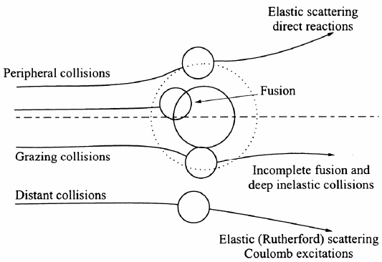
Compound-Nucleus Reactions
Compound-nucleus formation can only take place over a restricted range of small impact parameters
  can define critical angular momentum above which complete fusion cannot occur
  σ_{cf}/σ_{R} decreases with increasing bombarding energy
Neutron deficient heavy ions produce compound nuclei on neutron-deficient side of β stability belt
Heavy ion of energy above Coulomb barrier brings enough excitation energy to evaporate several nucleons
  5-10 MeV deexcitation for neutron evaporation
heavy-ion reactions needed for reaching predicted island of stability around Z=114 to N=184
U is excitation energy, M_{A} and M_{a} masses of target and projectile, T_{a} is projectile kinetic energy, S_{a} is projectile binding energy in compound nucleus

Slide 30
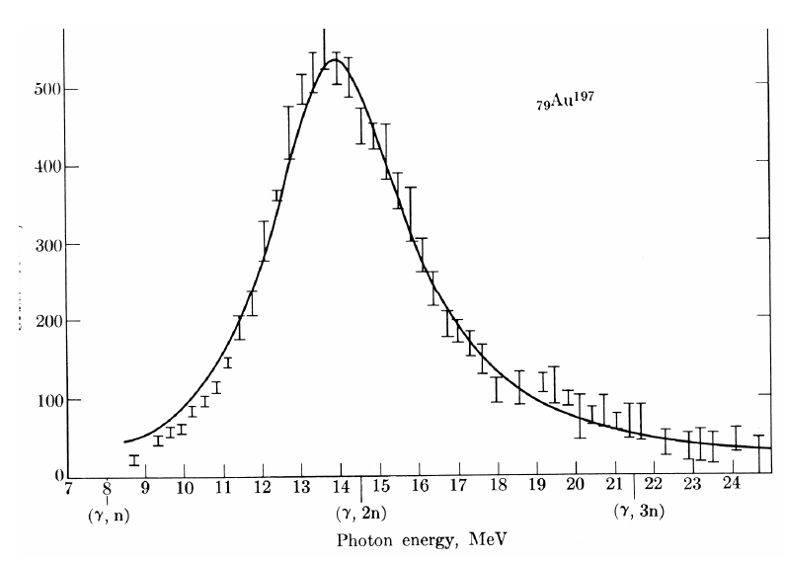
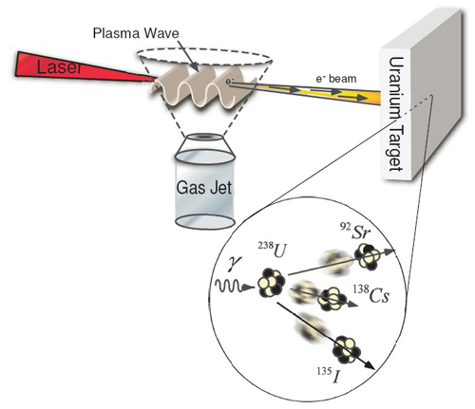
Photonuclear reactions
Reactions between nuclei and low- and medium-energy photons dominated by giant resonance
  Excitation function for photon absorption goes through a broad maximum a few MeV wide
    Due to excitation of dipole vibrations of protons against neutrons in the nucleus
Resonance peak varies smoothly with A
  24 MeV at ¹⁶O
  13 MeV at ²⁰⁹Bi
Peak cross sections are 100-300 mb
(γ, p), (γ, n), (γ,α) reactions
http://www.engin.umich.edu/research/cuos/ResearchGroups/HFS/Research/photonuclear_reactions.html

Slide 31
Natural Element Production
Nuclear Astrophysics
  fundamental information on the properties of nuclei and their reactions to the
  perceived properties of astrological objects
  processes that occur in space
Nuclear reactions responsible for production of elements
  Occurs in stars
At temperatures and densities
  light elements are ionized and have high enough thermal velocities to induce a nuclear reaction
  heavier elements were created by a variety of nuclear processes in massive stellar systems
systems must explode to disperse the heavy elements
  distribution of isotopes here on earth
underlying information on the elemental abundances
nuclear processes to produce the primordial elements

Slide 32
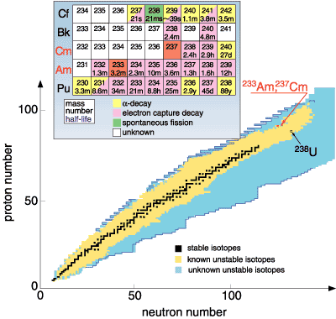
Chart of the nuclide trends
Actinides some distance from stable elements

Slide 33
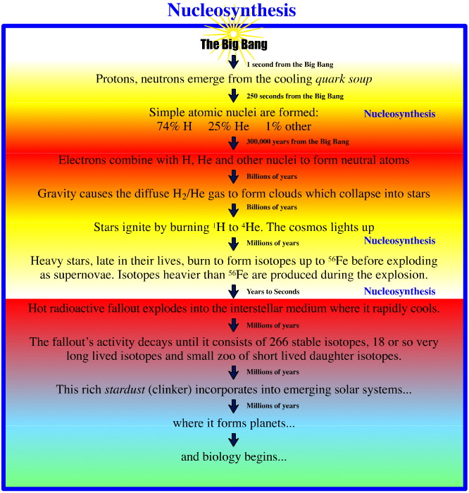
Timeline
Big bang 15E9 years ago
Temperature 1E9 K
Upon cooling influence of forces felt
  2 hours
    H (89 %) and He (11 %)
  Free neutrons decay

Slide 34
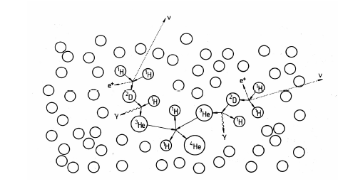
Origin of Elements
Gravitational coalescence of H and He into clouds
Increase in temperature to fusion
Proton reaction
  ¹H + n → ²H + γ
  ²H + ¹H → ³He
  ²H + n → ³H
  ³H + ¹H → ⁴He + γ
  ³He + n → ⁴He + γ
  ³H + ²H → ⁴He + n
  ²H + ²H → ⁴He + γ
  ⁴He + ³H → ⁷Li + γ
  ³He+⁴He → ⁷Be + γ
    ⁷Be short lived
    Initial nucleosynthesis lasted 30 minutes
      Consider neutron reaction and free neutron half life
Further nucleosynthesis in stars
  No EC process in stars

Slide 35
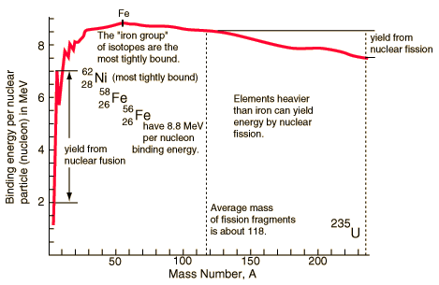
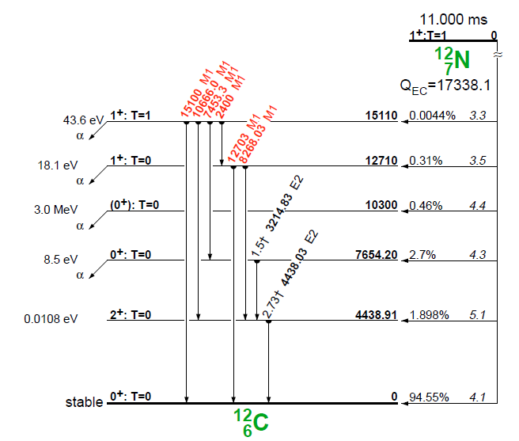
Stellar Nucleosynthesis
He burning
  ⁴He + ⁴He ↔ ⁸Be + γ - 91.78 keV
    Too short lived
  3 ⁴He → ¹²C + γ + 7.367 MeV
  ¹²C + ⁴He →¹⁶O
  ¹⁶O + ⁴He →²⁰Ne
Formation of ¹²C based on Hoyle state
  Excited nuclear state
    Somewhat different from ground state ¹²C
  Around 7.6 MeV above ground state
  0+
Fusion up to Fe
  From binding energy curve
  Maximum at Fe

Slide 36
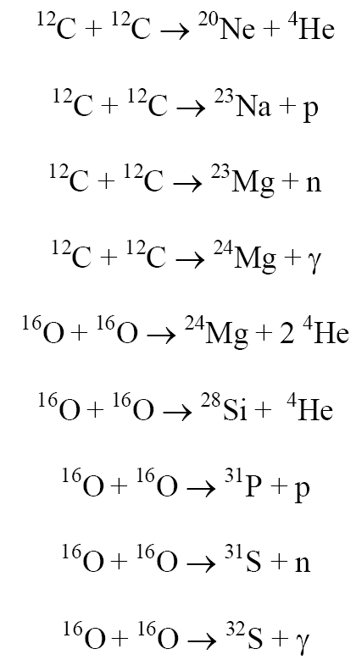
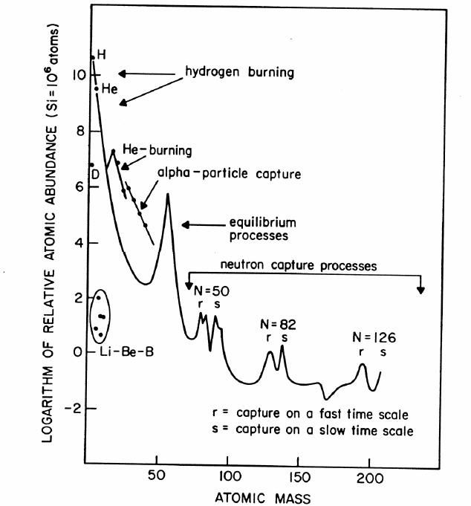
Stellar Nucleosynthesis
CNO cycle
  ¹²C + ¹H →¹³N + γ
  ¹³N →¹³C + e⁺+ νe
  ¹³C + ¹H →¹⁴N + γ
  ¹⁴N + ¹H →¹⁵O + γ
  ¹⁵O →¹⁵N + e⁺ + νe
  ¹⁵N + ¹H →¹²C + ⁴He
  Net result is conversion of 4 protons to alpha particle
    4 ¹H → ⁴He +2 e⁺+ 2 νe +3 γ

Slide 37
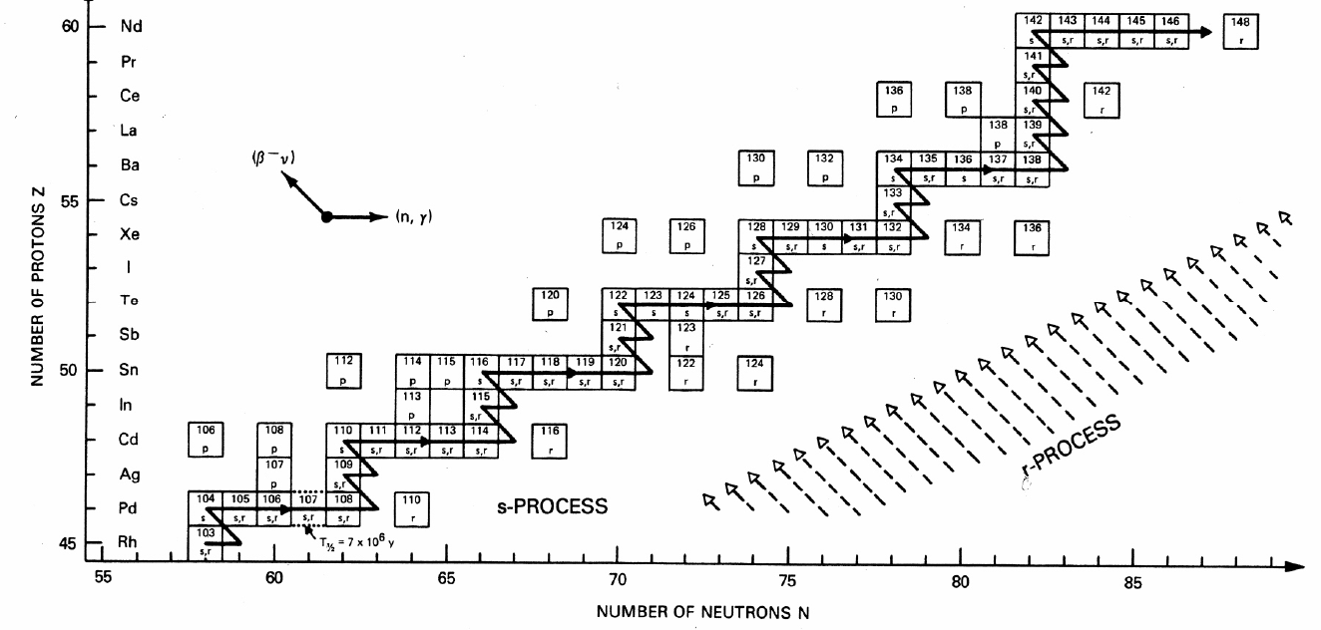
Formation of elements A>60
Neutron Capture; S-process
  A>60
  ⁶⁸Zn(n, γ) ⁶⁹Zn, ⁶⁹Zn → ⁶⁹Ga + β⁻ + ν
  mean times of neutron capture reactions longer than beta decay half-life
    Isotope can beta decay before another capture
  Up to Bi

Slide 38
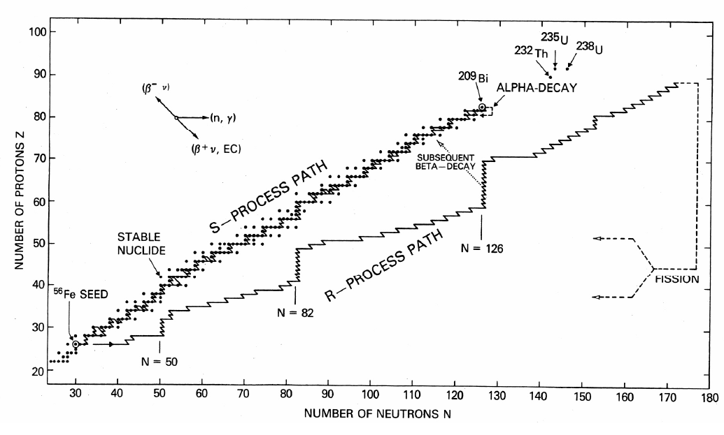
Nucleosynthesis: R process
Neutron capture time scale very much less than β- decay lifetimes
Neutron density 10²⁸/m³
  Extremely high flux
  capture times of the order of fractions of a second
  Unstable neutron rich nuclei
rapidly decay to form stable neutron rich nuclei
all A<209 and peaks at N=50,82, 126 (magic numbers)

Slide 39
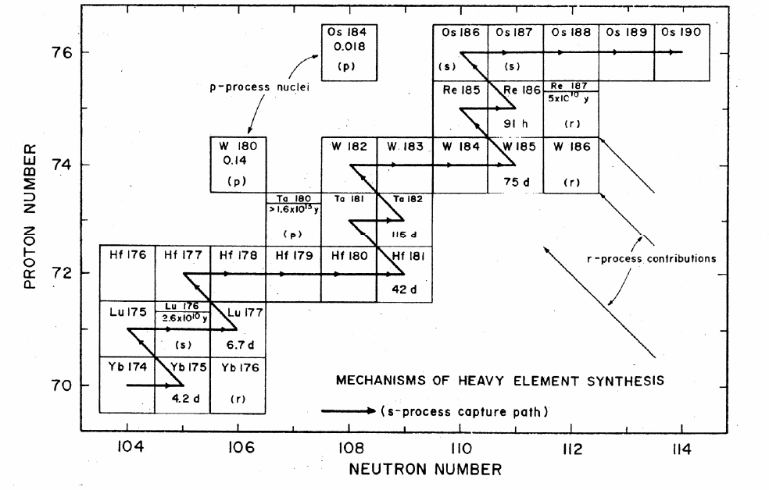
P process
Formation of proton rich nuclei
Proton capture process
70<A<200
Photonuclear process, at higher Z (around 40)
  (γ, p), (γ,α), (γ, n)
  ¹⁹⁰Pt and ¹⁶⁸Yb from p process
Also associated with proton capture process (p,γ)
Variation on description in the literature

Slide 40
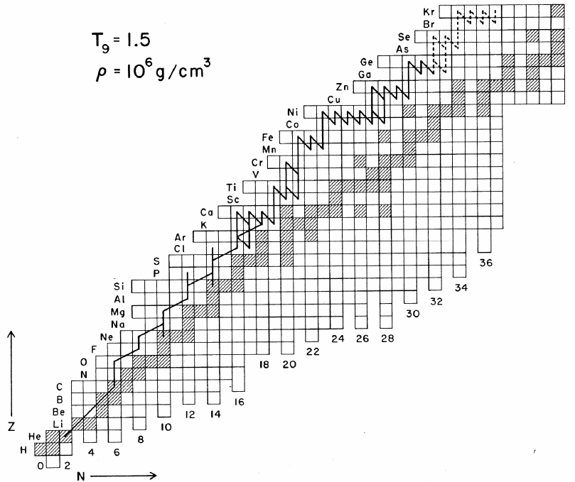
rp process
(rapid proton capture)
Proton-rich nuclei with Z = 7-26
  Forms a small number of nuclei with A< 100
(p,γ) and β⁺ decays that populate the p-rich nuclei
  Also associated with rapid proton capture process
Initiates as a side chain of the CNO cycle
  ²¹Na and ¹⁹Ne

Slide 41
Review Notes
Understand Reaction Notation
Understand Energetics of Nuclear Reactions
  Q values and barriers
Understand the Different Reaction Types and Mechanisms
  Particles
  Energy
Relate cross sections to energy
Describe Photonuclear Reactions
Routes and reactions in nucleosynthesis
Influence of reaction rate and particles on nucleosynthesis

Slide 42
Questions
Describe the different types of nuclear reactions for heavy ions.
Provide notations for the following
  Reaction of ¹⁶O with ²⁰⁸Pb to make stable Au
  Formation of Pu from Th and a projectile
Find the threshold energy for the reaction of ⁵⁹Co and an alpha that produces a neutron and a product nuclei
What are the differences between low and high energy reactions?
How does a charged particle reaction change with energy? A neutron reaction?
How are actinides made in nucleosynthesis?
What is the s-process?
What elements were produced in the big bang?
Which isotopes are produced by photonuclear reactions?
What is interesting about the production of ¹²C

Slide 43
Question
Respond to PDF Quiz
Comment in blog

